Slide 1
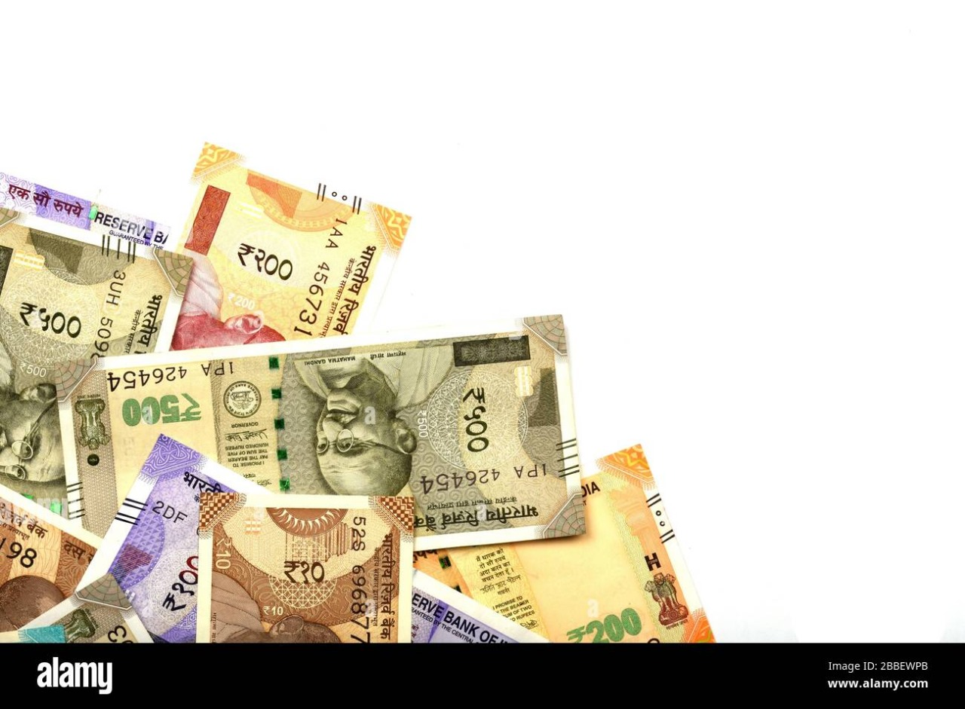
FAKE CURRENCY DETECTION
B.MARY -121322030002
K.DIVYA - 121322030013
N.LAVANYA-121322030018

Slide 2
ABSTRACT
Fake Currency has always been an issue which has created a lot of problems in the market. There are machines present at banks and other commercial areas to check the authenticity of the currencies. But a common man does not have access to such systems and hence a need for a software to detect fake currency arises, which can be used by common people.
This proposed system uses Image Processing to detect whether the currency is genuine or counterfeit. The system is designed completely using Python programming language. It consists of the steps such as grayscale conversion, edge detection, segmentation, etc. which are performed using suitable methods.

Slide 3
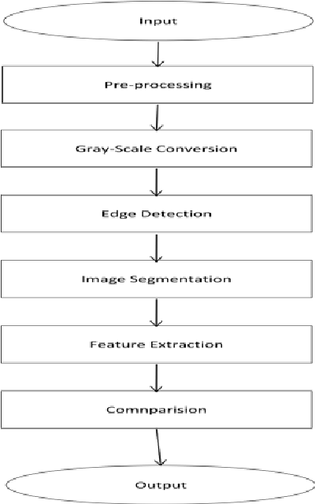
METHODOLOGY

Slide 4
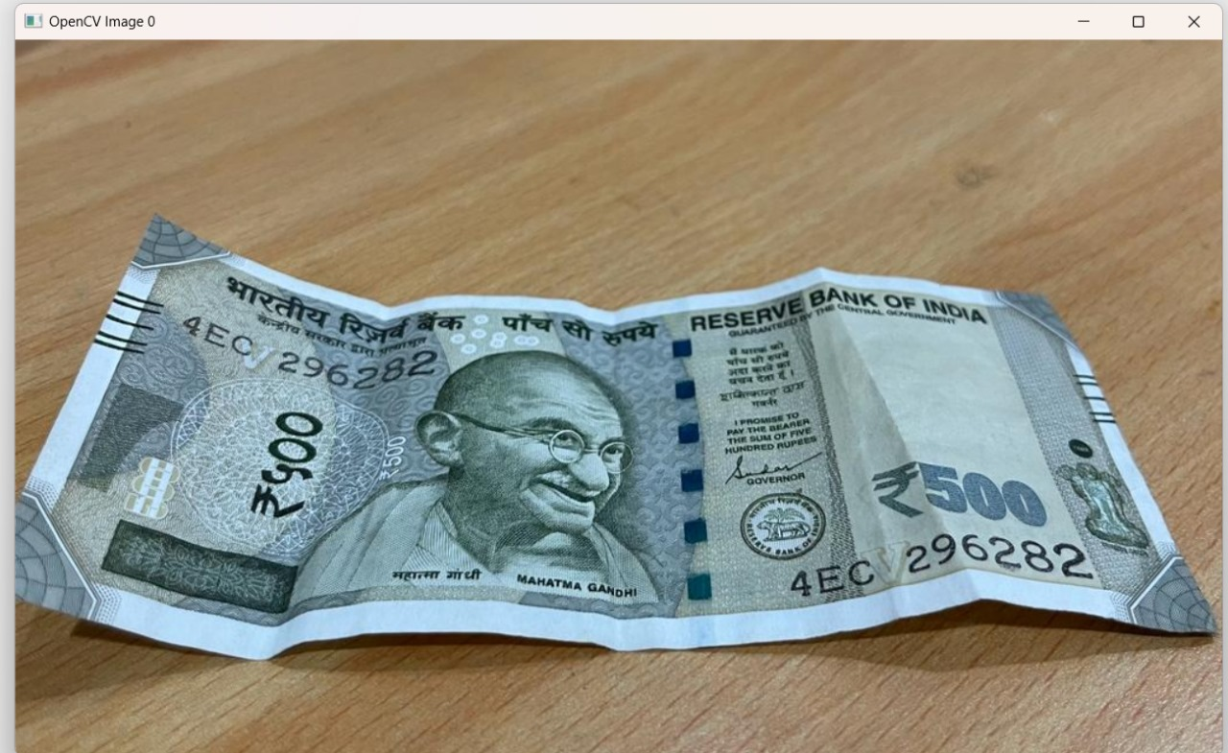
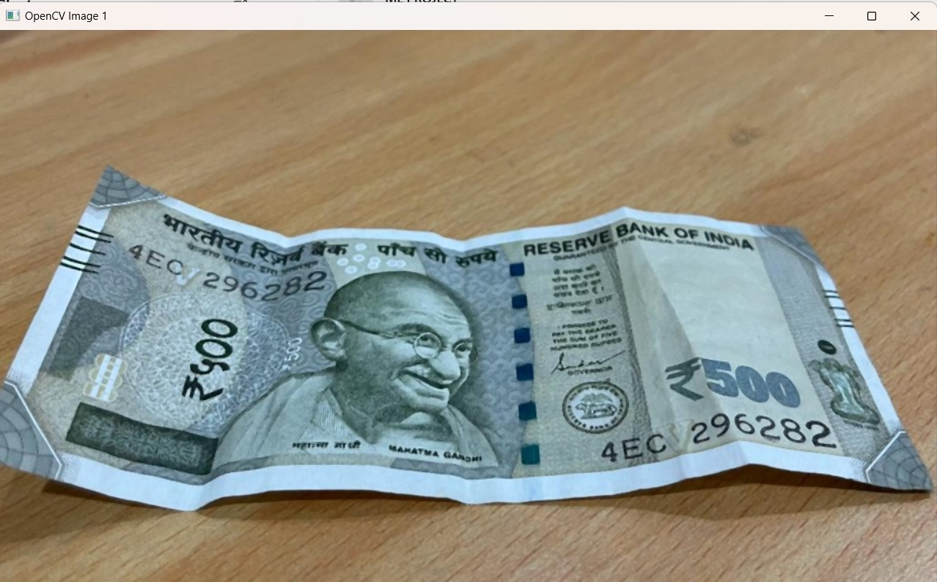
How it works?
IMAGE
PRE-PROCESSING
INPUT IMAGE

Slide 5
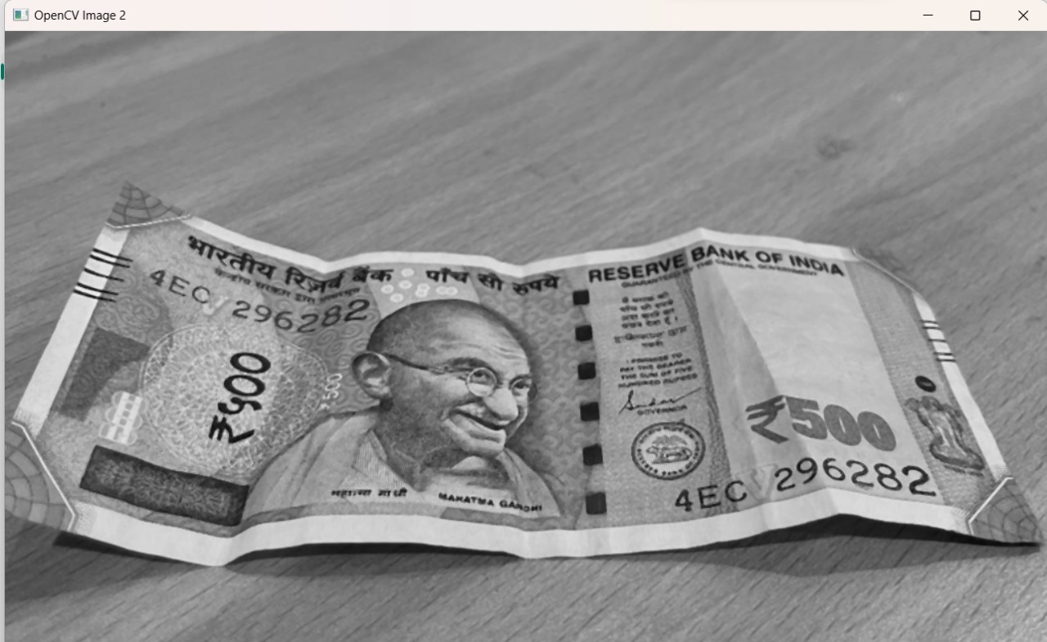
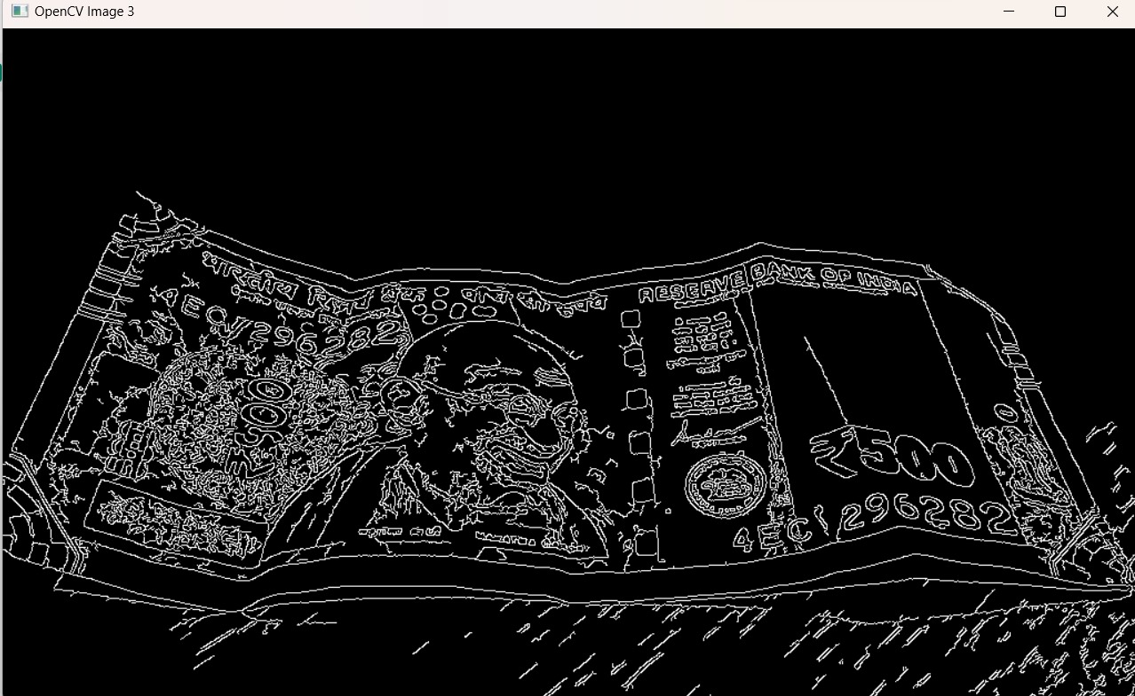
GREY – SCALING CONVERSION
EDGE DETECTION

Slide 6
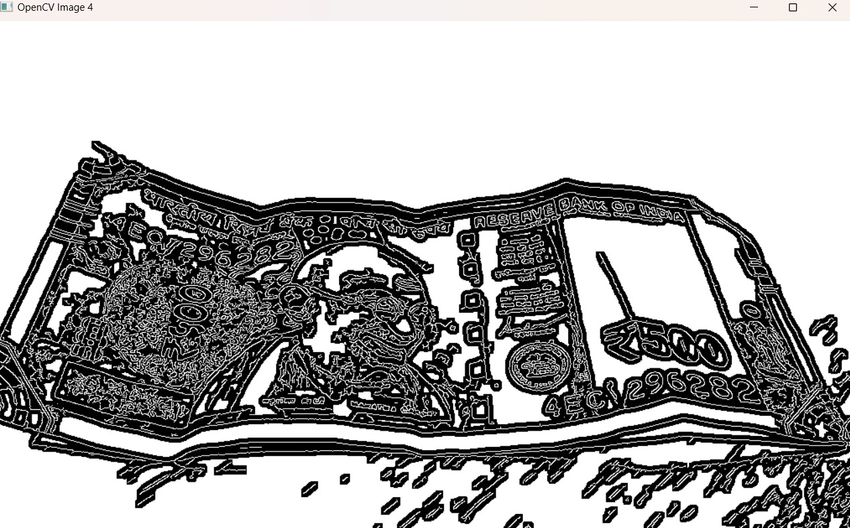
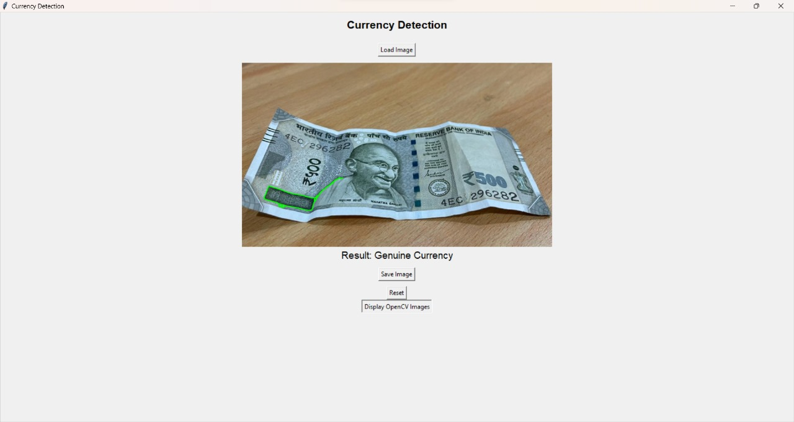
IMAGE SEGMENTATION
OUTPUT

Slide 7
CONCLUSION
The detection of fake currency is a critical and ongoing endeavor, essential for maintaining the integrity of financial systems and ensuring public trust in currency. Advances in technology, such as machine learning algorithms and sophisticated counterfeit detection tools, have significantly improved our ability to identify counterfeit bills. However, the fight against counterfeit currency requires constant vigilance, collaboration among governments and financial institutions, and ongoing public awareness to stay one step ahead of counterfeiters. Ultimately, a combination of advanced technology, effective enforcement, and public education is crucial in the ongoing battle against fake currency.

Slide 8


